Slide 1
Archive
Oct. 2018
Kay Kasemir

Slide 2
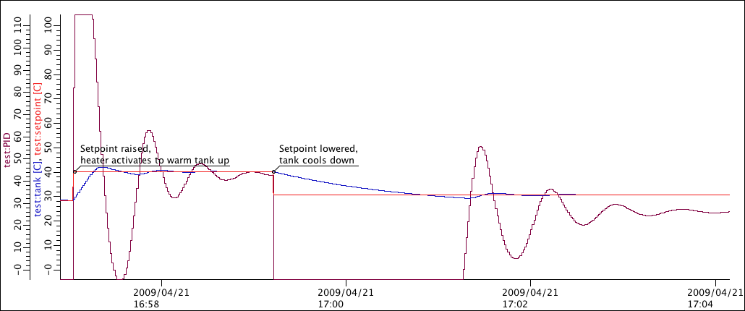
Idea
Archiver
IOC
CA Server
PVA Server

Slide 3
Practice
Configuration:
Which channels? How?
Storage Tons of fast storage
Archive Engine (Service)
Read PVs, write to storage
CA, PVA
IOC

Slide 4
Choices…
Channel Archiver: XML config, custom file storage
Fast
Fragile
Data access via C++ library & web service
Can’t be maintained as setup grows
RDB: RDB for both config and storage
Slow
Robust
Access from any piece of code
Very maintainable for decades
SLAC Archiver Appliance: RDB config, custom protobuf storage
Fast
Robust?
Web service
Maintainable over time?

Slide 5
IOC Configuration
Archive engines subscribe to “archive” events (DBE_ARCHIVE)
camonitor –m l the_pv_name
For analog records, configure the ADEL field
Unfortunately not perfect for ‘log’ type values like vacuum pressures
Assert that your IOC knows the time
Check time stamps reported by camonitor

Slide 6
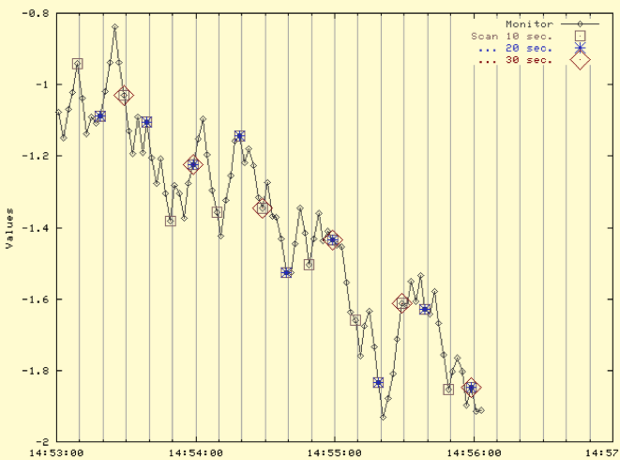
Archive Engine Options
Monitor
Tries to save every received update
Based on ADEL
Might need an expected-update-rate to allocate buffers, skipping samples if there are too many
Scan
Writes the most recent value every N seconds
Stores original time stamps

Slide 7
Setup of RDB Archive
See phoebus online help or https://github.com/shroffk/phoebus/blob/master/services/archive-engine/doc/index.rst
Install MySQL
Setup archive tables

Slide 8
Configure RDB Archive
cd ~/epics-train/examples/archive/
archive_engine -help
archive_engine -list
archive_engine -engine Demo -export `pwd`/Demo.xml
archive_engine -engine Fishtank -import `pwd`/Fishtank.xml
archive_engine -engine Fishtank –settings my_settings.ini
Check http://localhost:4812 in web browser

Slide 9
Viewing Archived Data
Open Data Browser, add PV
Data Browser Preferences:
org.csstudio.trends.databrowser3/urls=jdbc:mysql://localhost/archive|RDB org.csstudio.trends.databrowser3/archives=jdbc:mysql://localhost/archive|RDB org.csstudio.trends.databrowser3/use_default_archives=true

Slide 10
Archive
Fundamentally simple: Store values of PVs
There is no perfect implementation
Can’t store everything at high rate forever
Looking at data in Data Browser is easy

